Slide 1
NFTS
Presentation by Alexis McGuire

Slide 2
What are NFTs
A “non-fungible” token
A unit of data stored on a digital ledger
Uses a ethereum blockchain
Makes it possible to prove who owns the NFT
Anything digital can be an NFT
Music, videos, GIF, photos
Mainly used for Digital Art at the moment.

Slide 3

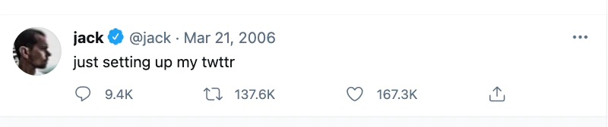
Examples of NFTS
Nyan Cat Gif
Jack Dorsey’s First ever Tweet
NBA video clips
Cryptokitties
Pokemon like trading cards but with cats
RTFKT’s digital sneakers
Bored Ape Avatars
Lazy Lion Avatars
Lazy Lions and Bored Apes are “dressup” like avatars similar to Picrew that NFT users use as icons

Slide 4
What is Ethereum?
A form of cryptocurrency
Similar to bitcoin or dogecoin
It is run through a blockchain that also supports NFTs
This way it can store extra information that make them work differently
1 ETH (ethereum) = $4,142
Work on a system called “proof of work”
It's incredibly energy hungry
Due to the high energy it comes with a “gas fee”
For security purposes, it forces users to complete complex puzzles using incredibly energy guzzling machines to keep everything secure

Slide 5
What is a “Blockchain” anyways?
A distributed databases that is shared among the nodes of a computer network
They store their information in “blocks” when one block is filled with information they close and link to the previous block forming a chain
Each block is given a exact time stamp when its added to the chain
This is how the information is relayed to others
The overall goal of the blockchain is to allow digital information to be recorded and distributed
But not edited!!

Slide 6
What is a “Blockchain” anyways? cont.
Blockchains are a distributed network, meaning the data that's held can be spread out among multiple network notes at many different locations
This creates security and also fidelity within the system
If one set of nodes is attacked in one location, another location will have the same set of information on their nodes
Because you can’t edit the information once it's in the blockchain its perfect for documenting transactions
Bitcoin, NFTs and smart contracts all use blockchain due to these two main reasons

Slide 7
Then what is an Ethereum Blockchain?
A transaction based system that uses blockchain technology as its base
The millions of transactions that Ethereum has are put into “blocks”
A block contains a series of transactions
Tied together with the previous block
For a block to go within the chain it must be considered “valid”
To become valid it must go through a validation process known as “mining”

Slide 8

Then what is an Ethereum Blockchain? cont.
Mining is where the miner provides a mathematical “proof” faster than anyone else
This process is the “proof of work” system that was discussed earlier
The puzzles are the systems way of having the miner provide the mathematical proof
Once it is is proven then the miner receives a digital token called an “Ether”
This ether token is what is used to then purchase NFTs

Slide 9
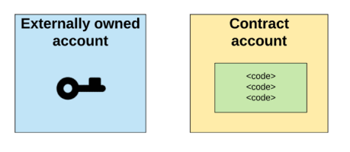
Ethereum Blockchain: Accounts
In order for someone to make a transaction they need to have an account
An account stores how much ethereum a user has
There are two types of accounts
Contract Accounts
Controlled by their contracted code
Externally owned Accounts
Controlled by private keys
Have no code associated with them

Slide 10
Accounts Cont.
An external account can send messages/transactions to other external accounts and contract accounts
By creating and signing transactions using its private key
Contract accounts cannot initiate transactions by themselves
Can only fire transactions in response to other transactions they’ve received
Any action that occurs on the Ethereum blockchain is always set in motion by externally controlled accounts transactions

Slide 11
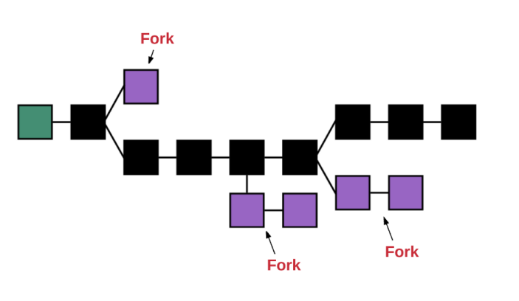
Ethereum Blockchain: POW
There is typically only one ethereum blockchain that everyone “believes in”
One long blockchain containing all of the information
Having multiple chains would ruin the system due to it being impossible to agree on which state was the correct one
If they were to diverge, you might own 10 coins on one, 20 on another and 40 on another
This would make it so no one could determine which one is “valid”
Whenever multiple paths are generated due to two miners trying to insert information at the same time a “Fork” occurs
We want to avoid forks because they mess with the system and make users choose what chain they “believe in”

Slide 12
POW and Forks cont.
To determine which chain is the most valid it uses the “GHOST protocol”
Greedy, Heaviest, Observed, Subtree
It says that we pick the path that has the most done on it
The most blocks in the chain
To do this it looks at the block number fo the most recent block
Not counting the starting, or Genesis, block
The Genesis block starts at 0 and has no information so its not counted
The higher the block number, the longer the chain is and the greater the mining effort to get to that number
It uses this reasoning to agree on the “Canonical blockchain”

Slide 13
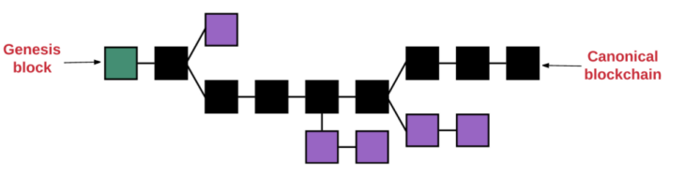
Forks Cont.
A full Ethereum blockchain.

Slide 14
Ethereum Blockchain vs “Typical” Blockchain
The ethereum blockchain runs off of ethereum to power everything
While a typical blockchain is a database of information
Ethereum blockchain uses the framework of a blockchain in order to turn transactions into digital tokens
Ethereum blockchains need to be “validated” in order to become part of the chain
Blocks only need to be filled in order to become part of the overall blockchain
Ethereum needs specialized accounts in order to do transactions
If multiple people insert information into the system, Forks occur
Ethereum has a specific protocol for this
For verification

Slide 15
How are they bad for the environment?
Due to the energy amount ethereum takes, it wastes a lot of energy to buy and sell NFTs.
Takes a lot of power to run the servers that run the cryptocurrency banks
This insane amount of energy can contribute to the global impact that’s already affecting the environment
Climate change, pollution, etc.

Slide 16
How much energy do they take up?
According to Statistica
1 Ethereum transaction = 178.89 kilowatt-hours of power
100,000 VISA transactions = 148.63 kilowatt-hours of power

Slide 17
How much energy do they take up?
On average people pay around 12.87¢/kWh
The average household uses around 28.9 kWh/day
So around $3/day towards electricity
The 178.89 kilowatt-hours of power an ethereum for a single transaction
Could fuel the average household for around a week
Around $23 dollars in electricity

Slide 18
Why does it matter?
All of these numbers add up very quickly over time
For Example
William Shatner had a series of memorabilia NFTs in 2020 of photos from his career
In 9 minutes he sold 125,000 units of these photos
125,000 x 178.89 = 22,361,250 kWh
This multiplied by the average cost of a kWh
288,236,512.5 / 100 (cents/dollar) =~ $2,882,365.125

Slide 19
Why does it matter? cont.
This number also compared to the average household every day
22,361,250 /28.9 kWh = ~773,745.67 days to run the average household
All of this energy for a fraction of one campaign of NFTs that can be right clicked and saved for free
One of the NFTs that I literally right clicked for free to put here

Slide 20
Where to NFTs fail as a concept?
Digital is not a physical object
In terms of Art NFTs, the copy of the art is just as valuable as the original one
The “Right-Click”
Anyone can right click on a digital file and save them as your own without paying
I’ve done this several times just for this presentation

Slide 21
Works Cited
Best, Raynor de. “Ethereum Energy Consumption 2021.” Statista, Statista, 21 Oct. 2021, https://www.statista.com/statistics/1265891/ethereum-energy-consumption-transaction-comparison-visa/.
Calma, Justine. “The Climate Controversy Swirling Around NFTs.” The Verge, The Verge, 15 Mar. 2021, https://www.theverge.com/2021/3/15/22328203/nft-cryptoart-ethereum-blockchain-climate-change.
Clark, Mitchell. “NFTs, Explained.” The Verge, The Verge, 3 Mar. 2021, https://www.theverge.com/22310188/nft-explainer-what-is-blockchain-crypto-art-faq.
Fard, Adam. “21 Examples of NFTs and How to Get Inspired By Them.” Adam Fard UX Studio | UI UX Design for Startups & Leading Brands, 2021, https://adamfard.com/blog/nfts-21-examples.
Kaczynski, Steve, and Scott Duke Kominers. “How NFTs Create Value.” Harvard Business Review, Harvard Buisness Review, 10 Nov. 2021, https://hbr.org/2021/11/how-nfts-create-value#:~:text=As%20the%20name%20%E2%80%9Cnon%2Dfungible,the%20history%20of%20prior%20ownership.
“Non-Fungible Token.” Wikipedia, Wikimedia Foundation, 29 Nov. 2021, https://en.wikipedia.org/wiki/Non-fungible_token.
“Welcome to Ethereum.” Ethereum.org, Ethereum.org, https://ethereum.org/en/.
“What Is a Kilowatt-Hour (Kwh) and What Can It Power?” ElectricityPlans, ElectricityPlans, 2021, https://electricityplans.com/kwh-kilowatt-hour-can-power/.

Slide 22
Works Cited Cont.
Casale-Brunet, S., et al. “Networks of Ethereum Non-Fungible Tokens: A Graph-Based Analysis of the ERC-721 Ecosystem.” Arxiv.org, Biomathematics and Statistics Scotland, United Kingdom2 DegenData.io, PinkSwanTrading Inc., United States of America3, 24 Oct. 2021, https://arxiv.org/pdf/2110.12545.pdf.
“The Network Effect of NFT.” Networks, Cornell University, 2 Nov. 2021, https://blogs.cornell.edu/info2040/2021/11/02/the-network-effect-of-nfts/.
Kim, Seoung Kyun, et al. “Measuring Ethereum Network Peers.” ACM Digital Library, ACM , 2 Nov. 2018, https://dl.acm.org/doi/pdf/10.1145/3278532.3278542.
Kasireddy, Preethi. How Does Ethereum Work, Anyway? 10 Jan. 2017, http://www.easygoing.pflog.eu/32_blockchain_P2P/ethereum_blockchain.pdf.
Casino, Fran, et al. “A Systematic Literature Review of Blockchain-Based Applications: Current Status, Classification and Open Issues.” Telematics and Informatics, Pergamon, 22 Nov. 2018, https://www.sciencedirect.com/science/article/pii/S0736585318306324.
Tredinnick, Luke. “Cryptocurrencies and the Blockchain - Luke Tredinnick, 2019.” SAGE Journals, SAGE Journals, 19 Mar. 2019, https://journals.sagepub.com/doi/full/10.1177/0266382119836314.

